Slide 1

Unit 5: Lesson 2: Career day

Slide 2
Task 2: Circle the jobs that require a university degree.
Task 3: Choose five jobs from task 2 and describe them.
E.g.:
An architect works in an office. His/her job is to design new buildings and houses. This job recquires a university degree. He/she doesn’t have to wear a uniform at work. He/she spends a lot of time in front of a computer.

Slide 3
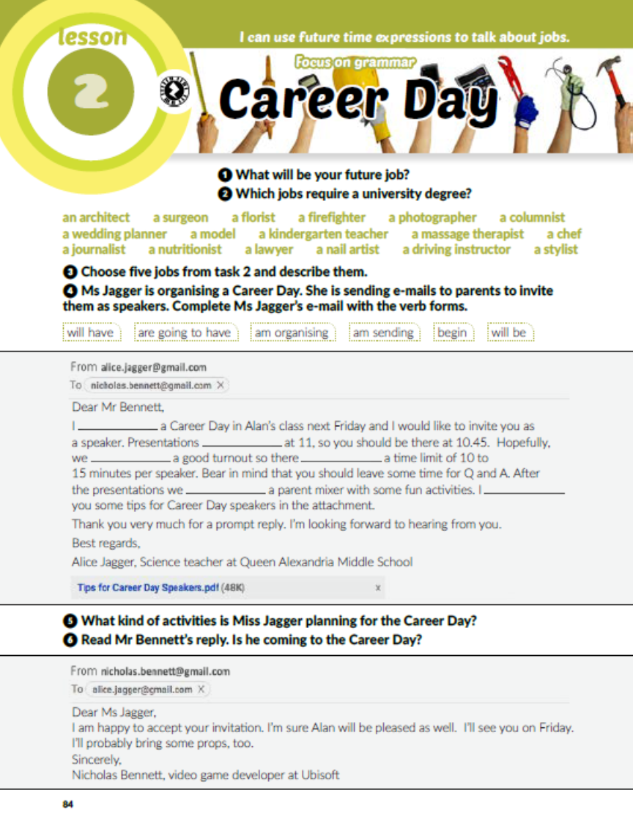
Task 4: Complete Ms Jagger’s e-mail with the verb forms.
am organising
begin
will have
will be
are going to have
am sending

Slide 4

Task 5: What kind of activities is Miss Jagger planning for the Career Day?
Task 6: Read Mr Bennett’s reply. Is he coming to the Career Day?
Presentations, Q and A, a parent mixer.
Yes, he is.

Slide 5
Task 6: Mr Bennett is talking to his son about the Career Day. What topics is he going to talk about? Listen and tick the correct answers.
https://www.e-sfera.hr/dodatni-digitalni-sadrzaji/3e5a4b73-e4cc-423f-81af-5ab96d5fd9c6/
✓
✓
✓
✓
✓

Slide 6
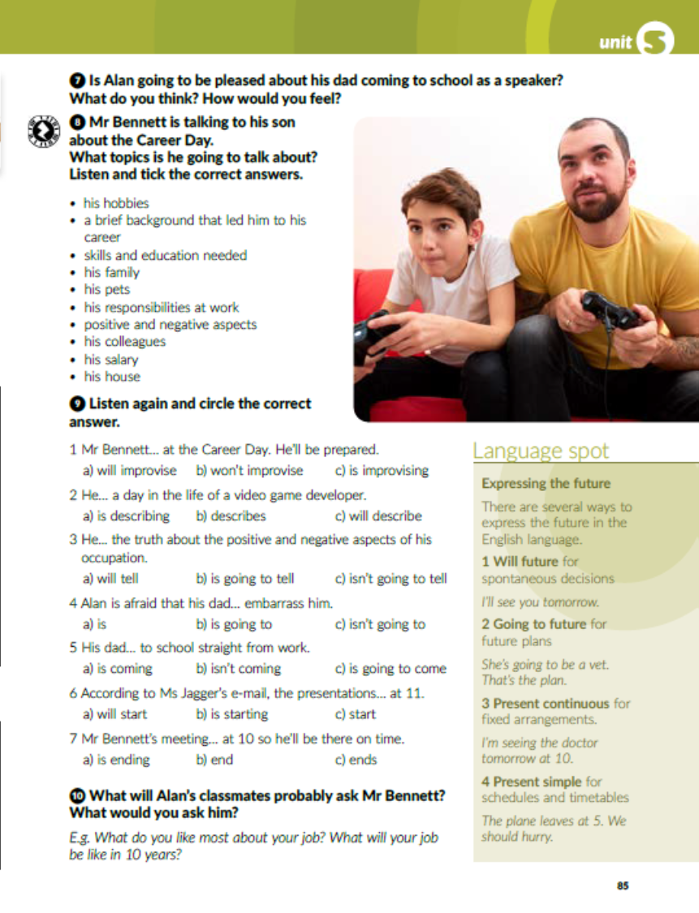
Task 9: Listen again and circle the correct answer.
https://www.e-sfera.hr/dodatni-digitalni-sadrzaji/3e5a4b73-e4cc-423f-81af-5ab96d5fd9c6/

Slide 7

Napiši naslov u bilježnicu – Expressing the future – i prepiši tekst u rubrici Language spot u bilježnicu.

Slide 8

Task 10: What will Alan’s classmates probably ask Mr Bennett? What would you ask him?

Slide 9
workbook, page 89
Task 1: Guess the word.
a i r t i s
a w y e
u r g e o
o l l e a g u
a l a r
c c u p a t i o
a r e r

Slide 10
Task 2: Match the situations and the responses.
2
6
7
4
5
3

Slide 11
Task 3: What is going to happen? Write the sentences using the going to future form of the verbs in brackets.
Will is going to call the police.
It is going to rain.
Sue isn’t going to buy the dress..
Ted is going to stay at home.
Michael is going to bake a pie..

Slide 12
Task 4: Complete the dialogue with the present simple or the present continuous tense of the verbs in brackets. Dovrši dijalog koristeći present simple ili present continuous.
are looking
am travelling
leaves
arrives
leaves
arrives
makes
am taking
doesn’t finish
doesn’t go
stops
am taking

Slide 13
Task 5: Complete the text with the correct future time forms of the verbs in the box.
is leaving
takes off
will text
is going to call
lands
am going to miss
will have
are going to visit
is going to check
opens

Slide 14

PLAY AND LEARN!
https://www.e-sfera.hr/dodatni-digitalni-sadrzaji/3e5a4b73-e4cc-423f-81af-5ab96d5fd9c6/

